Slide 1
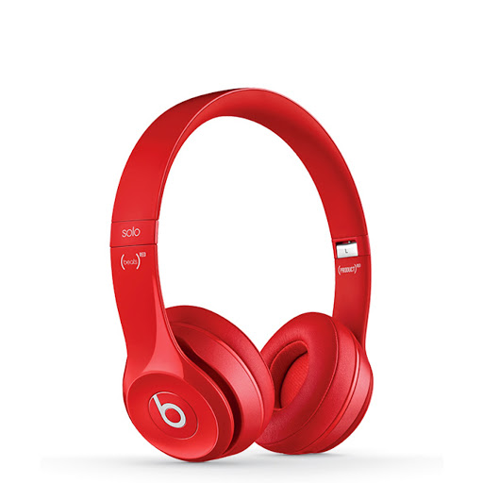
nat5 Design & Manufacture
Research Techniques and Evaluation

Slide 2
Learning intentions & success criteria
Learning Intentions
Developing my understanding of product evaluation.
Success Criteria
Understand the different ways to evaluate and compare existing products.
Conduct research online, in books and magazines, annotate these and compare existing products.

Slide 3
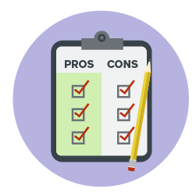
What is product evaluation?
You are a consumer when you buy or use a product.
As a consumer you have choices.
Evaluation of a product means that you are checking:
The suitability
Safety
Design
Whether it does the job it was intended to do
Meets the needs of the user
You must be able to identify the features of a product that makes it a success or a failure.

Slide 4
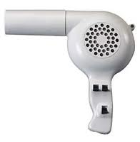
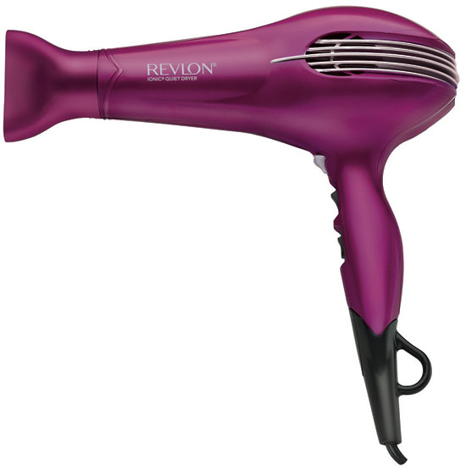
Why do we evaluate products already on the market?
When designers are designing new products to put on the market, it is important for them to look at other products that already exist.
By analysing current products, designers can:
Develop and improve these products
Learn lessons from earlier mistakes
Identify design faults to make their new designs better.

Slide 5
User trials
A group of users test/trial versions of products under controlled conditions and give their opinions on the products.
For example, they would test how this Garlic press functions or consider other aspects like performance, aesthetics etc.
In an exam question, you may be asked what kind of information a user would produce by trialling a particular product and focussing on a particular design factor.

Slide 6
User trip
This is different from a User trial as a person/group of people would test and give feedback on the whole process of using a product.
The trip would involve feedback on everything from Aesthetics, Performance, Durability, Function, Ergonomics etc.

Slide 7
Focus groups
Small number of people (usually between 4 and 15, but typically 8) are brought together with a moderator to focus on/discuss a specific product.

Slide 8
questionnaire
A list of research of survey questions asked to a larger group of people, designed to extract specific information.
A wide range of people can be sampled
Can be collated quickly
Specific questions can be asked eg aesthetics, ergonomics, function - to direct the person being surveyed
Can be written to suit the target market
A rating system can be used to further refine the process
The results are easy to present in the form of graphs/charts.

Slide 9
questionnaire
Key Stages in carrying out a questionnaire:
• Decide on the questions to be used
• Identify the target audience
• Test/check the questionnaire for example length/clarity
• Ask questions/distribute the questionnaire
• Collect results
• Analyse results.

Slide 10
Examining the product (observation)
By examining the product in detail, you can find out about:
Its construction
The materials
Processes used
How it has been assembled

Slide 11
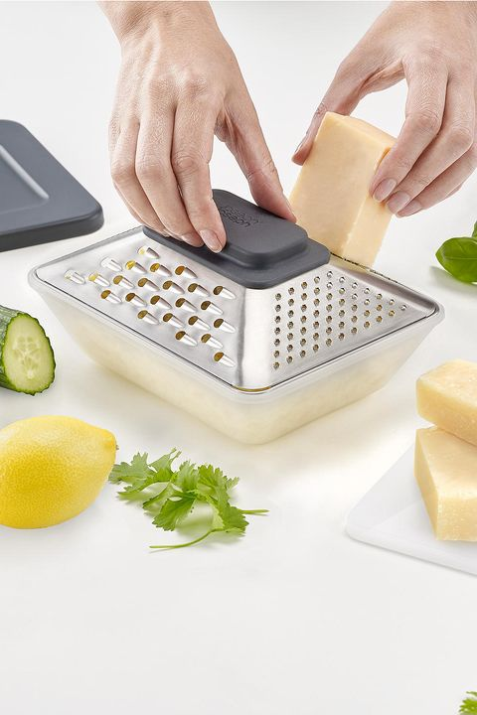
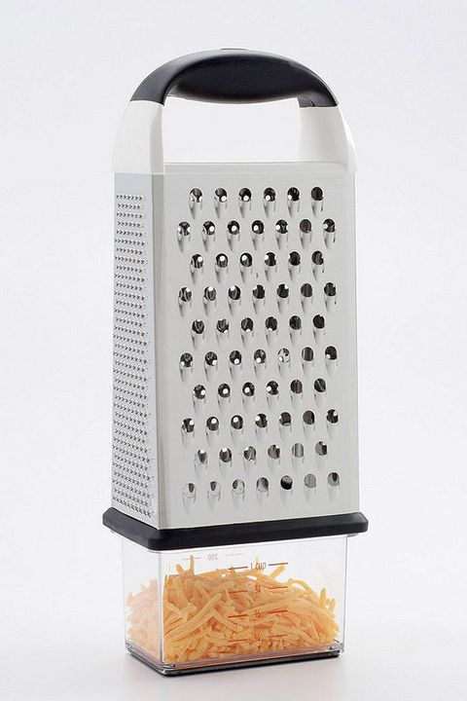
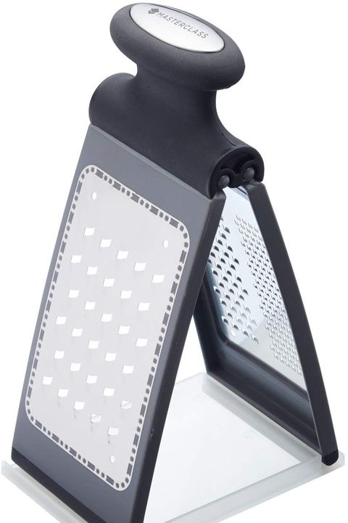
Product comparison
Looking at similar commercial products can highlight what is well designed about the product that you are evaluating.
If you use this method, you need to ensure that the products you compare are similar and being tested against the same criteria.

Slide 12
Introduction
Things that can be discussed when evaluating the existing product:
Function – primary and secondary, fit for purpose
Performance – easily maintained, good or bad for the environment, quality materials etc.
Market – is this product what consumers are looking for? Does it meet social expectations? Does it have a niche market?
Aesthetics – factors that affect the way it looks.
Ergonomics – anthropometrics, psychology, physiology
Economics – cost, safety, British Standards, value for money.

